Slide 1

Enhancing Operational Efficiency and Revenue Analysis
A Data-Driven Study for DTDC Courier Franchise Services
Name: Avishi Prasad
Roll No.: 23f2003893
IITM BDM Capstone Project

Slide 2
Executive Summary
DTDC Franchise in Kanpur (since 1997) facing 3 issues:
Data collected for October 2024, analyzed using Excel, Power BI, and Python (OpenRouteService)
Goal: Identify inefficiencies and provide actionable insights
  Lack of visibility in region-wise revenue
  High parcel returns
  Frequent delivery delays

Slide 3
Problem Statement and Objectives
Problem | Objective
Revenue Trends | Analyze revenue by region
Parcel Returns | Identify return rates & causes
Delivery Delays | Detect delay-prone routes

Slide 4
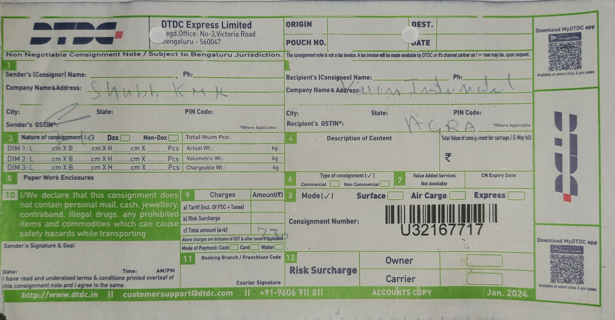
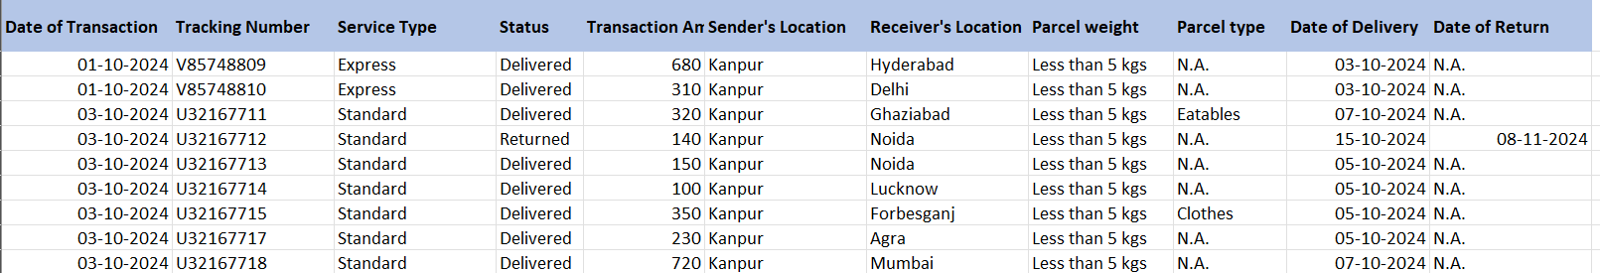
Data Collection and Tools
Source: Bills & POD forms (Oct 2024), 225 entries
Tools:
Cleaning: Normalization, deduplication, standardization
Excel: Cleaning, PivotTables, COUNTIF, AVERAGEIF
Power BI: Dashboard
Python: OpenRouteService API for distance/time

Slide 5
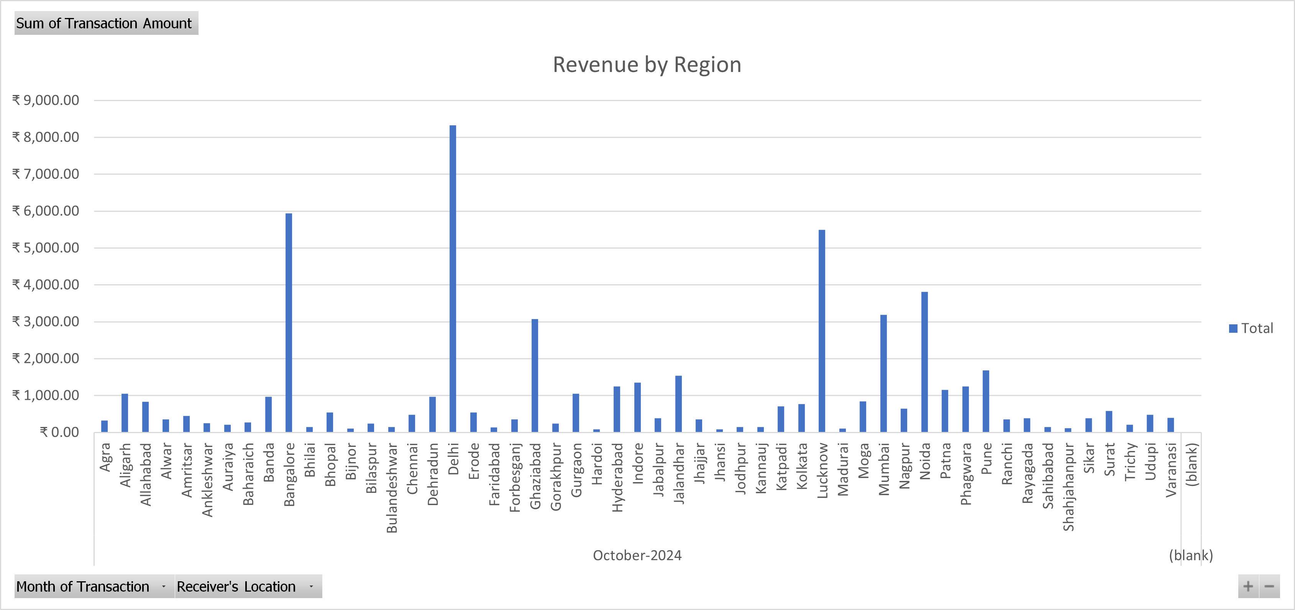
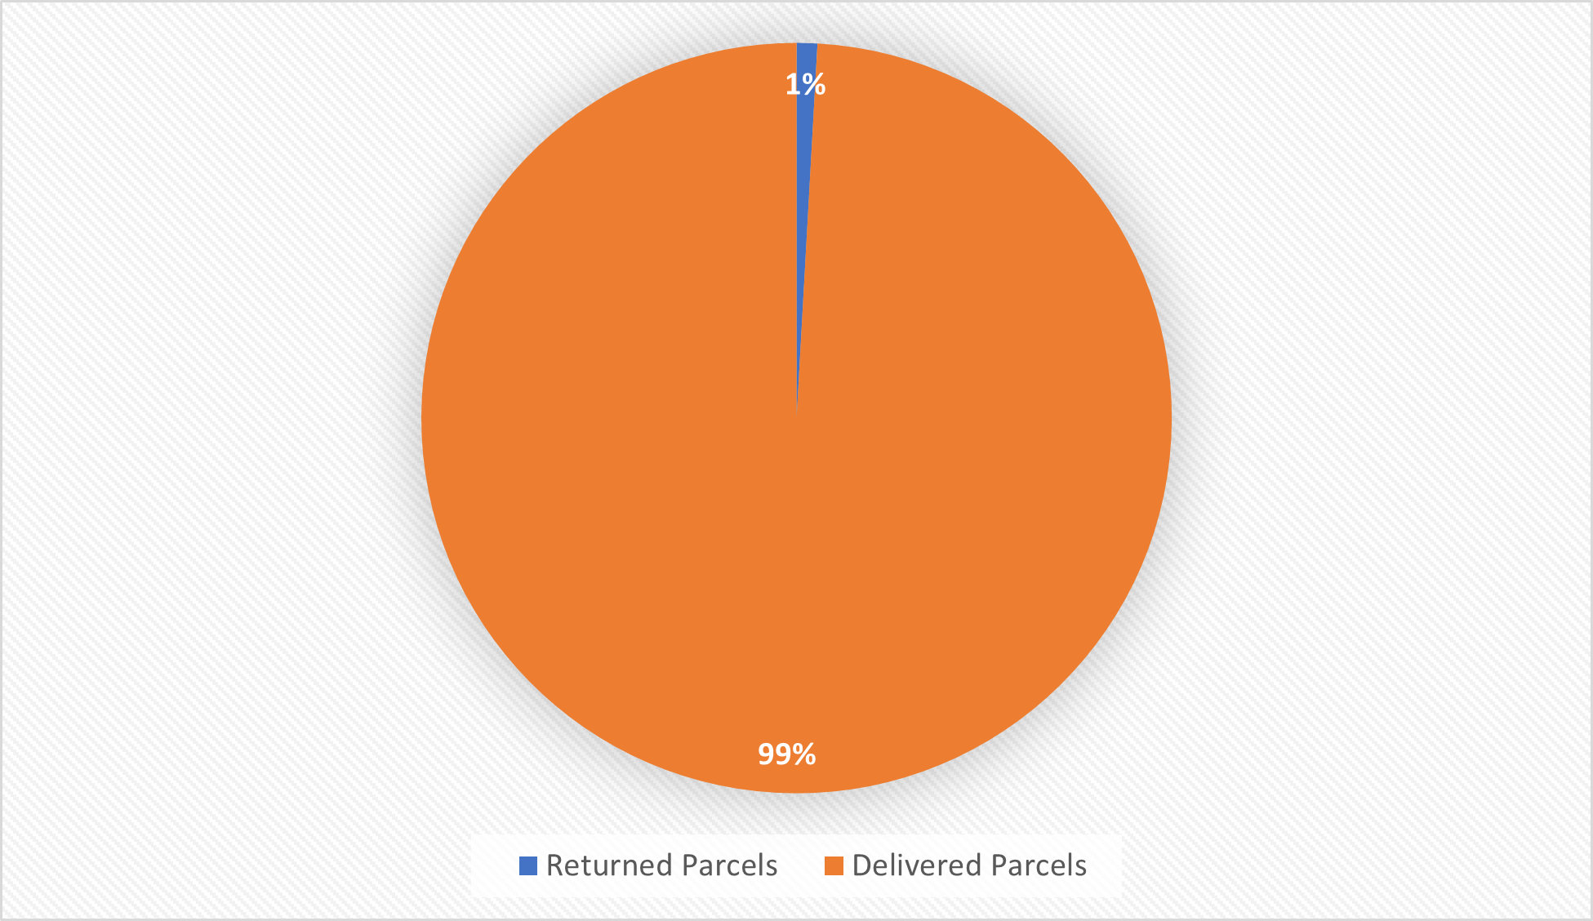
Key Findings – Revenue & Returns
Top Revenue Regions: Delhi (₹8,325), Bangalore, Lucknow
Underperforming: Jhansi & Hardoi
Returns: Only 2 returns (0.89%) → either real improvement or recording issue
Return hotspots: Jhajjar & Noida

Slide 6
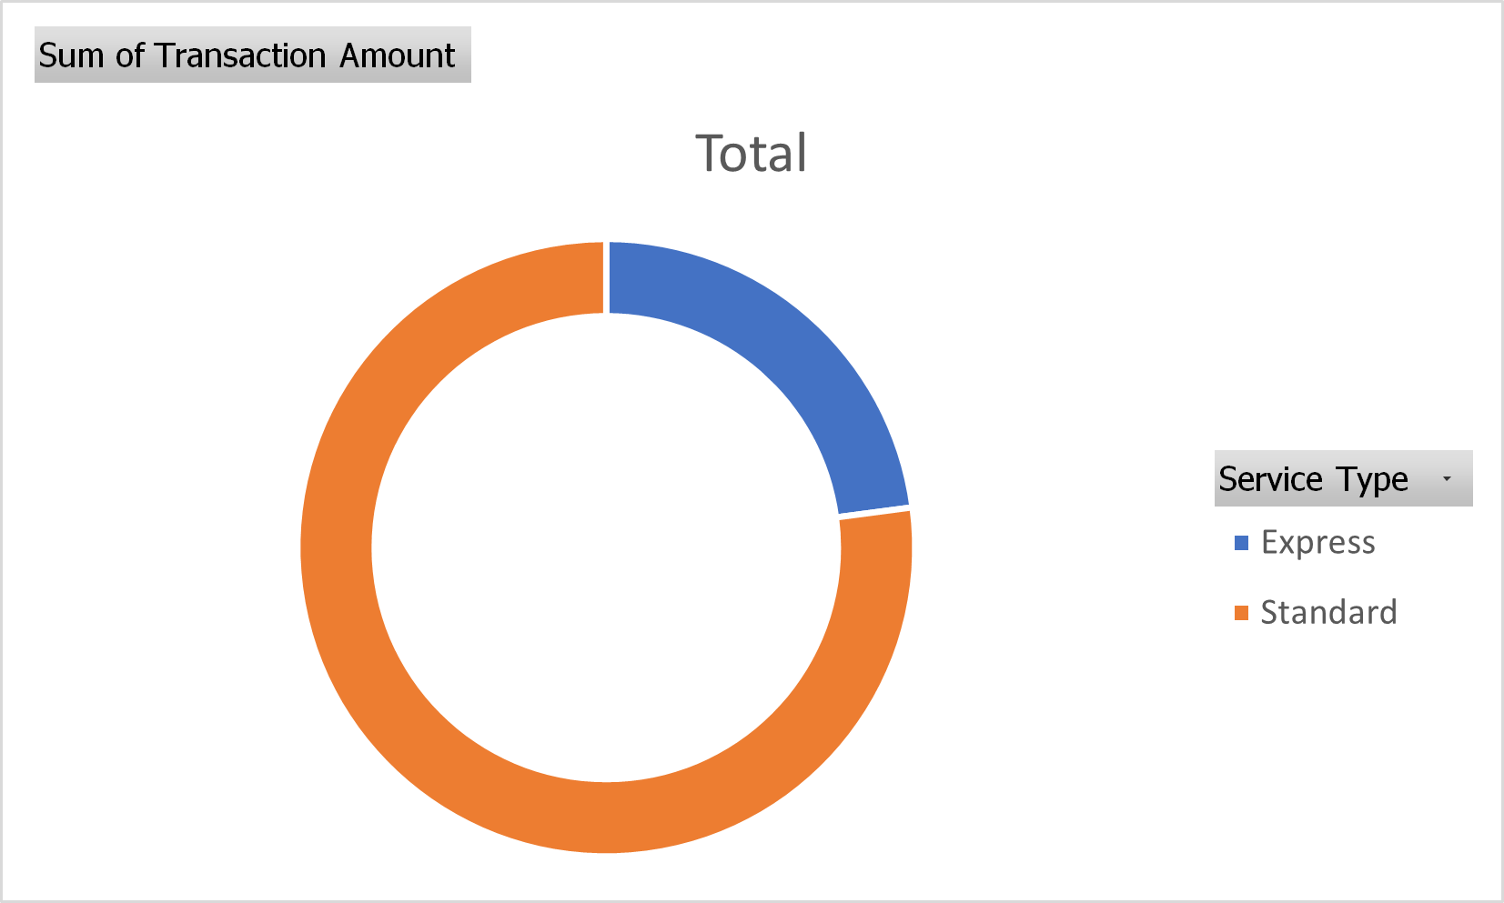
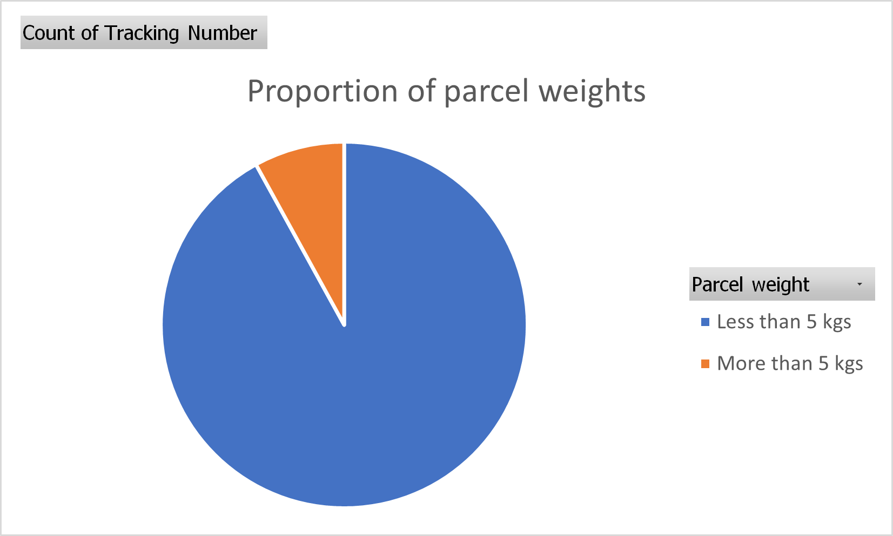
Key Findings – Service Type & Weight
Standard Service: 88% of parcels, 77% of revenue
Express Service: 12% of parcels, 23% of revenue
(for every 1% increase in volume, the revenue
increases by about 2%)
<5kg: 92% volume, 75% revenue
>5kg: 8% volume, 25% revenue (for every 1%
Increase in volume, the revenue increases by 3%)
Heavy parcels = higher profit, slightly longer
delivery

Slide 7
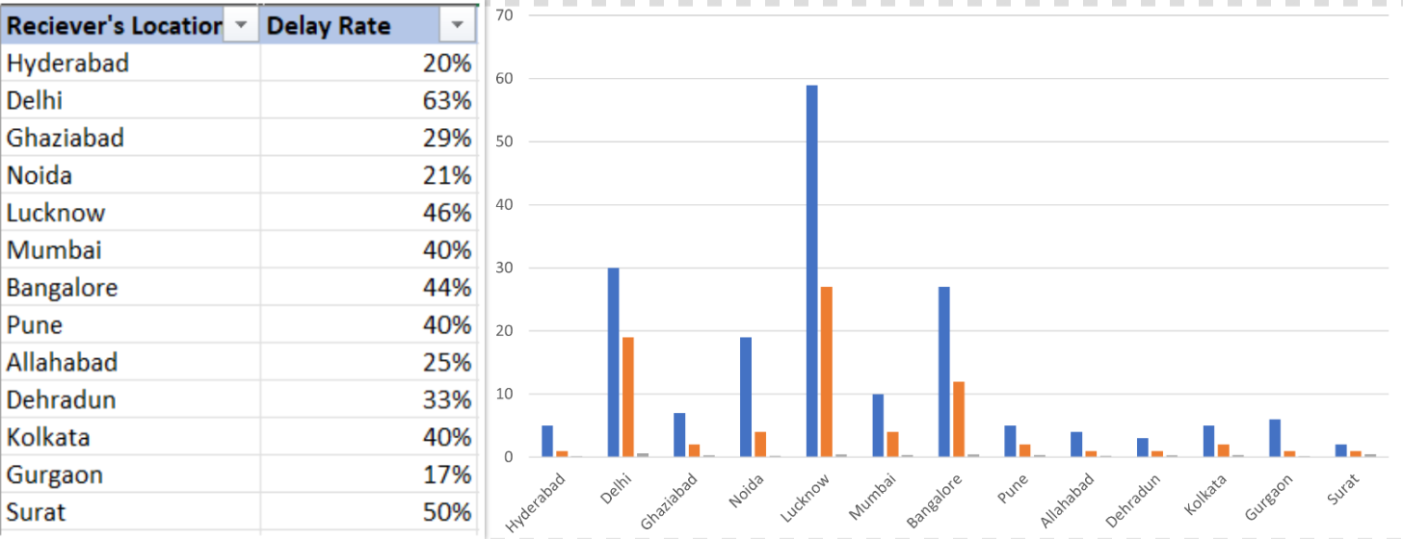
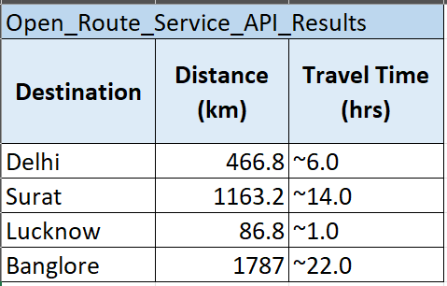
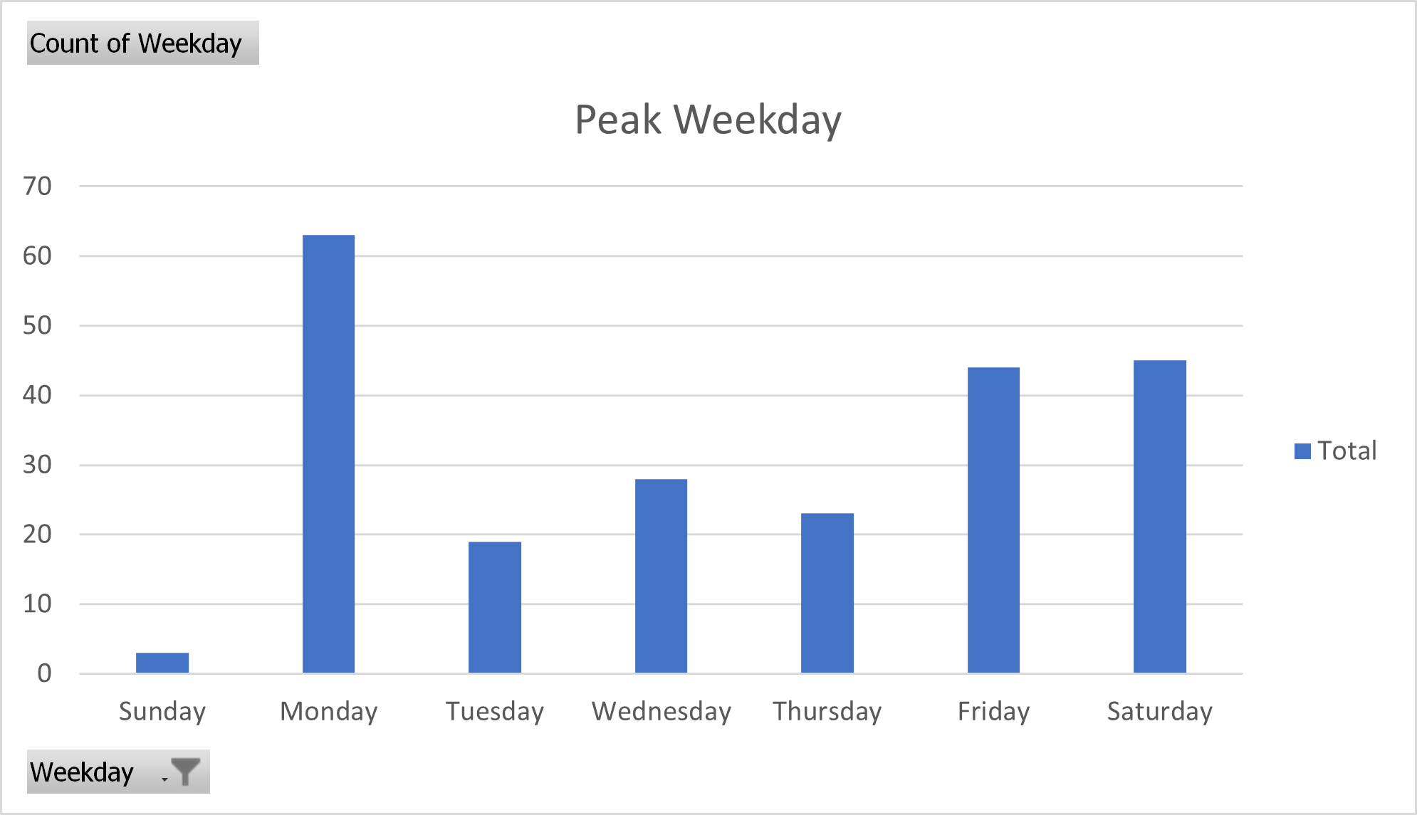
Key Findings – Delivery Delays & Patterns
34.53% of parcels delayed
Worst: Surat (50%), Delhi (63%)
API travel time validated delay pattern
(Surat = 14+ hours)
Peak Days: Monday (28%), Saturday (20%)
Least Active: Sunday, Tuesday

Slide 8







Recommendations
Promote express & heavy parcel use
Prioritize Surat & Delhi in dispatch
Digitize return logging
Realign staffing to peak days
Customer feedback collection

Slide 9
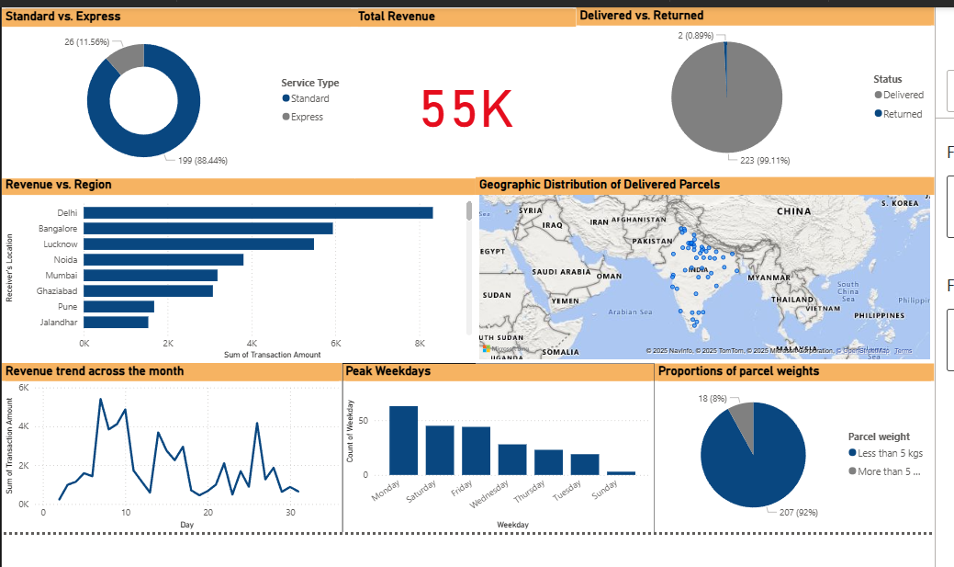
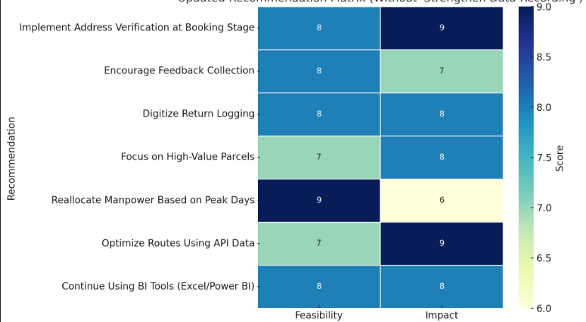
Dashboard Snapshot & Matrix
Screenshot of Power BI dashboard
Metrics: revenue, delay %,
return rate, parcel weights
Recommendation Matrix:
High-impact+ High-feasibility → Top Priority

Slide 10






Limitations & Future Scope
Limitations:
Future Work:
1-month dataset
Manual entry errors
Seasonal trends, Predictive ML models
Real-time route optimization
Customer sentiment via feedback
Automated dashboards with refresh

